Slide 1
Cornerstone City Church Peninsula Plus Community Hoo Are Ya
25th January 2026

Slide 2
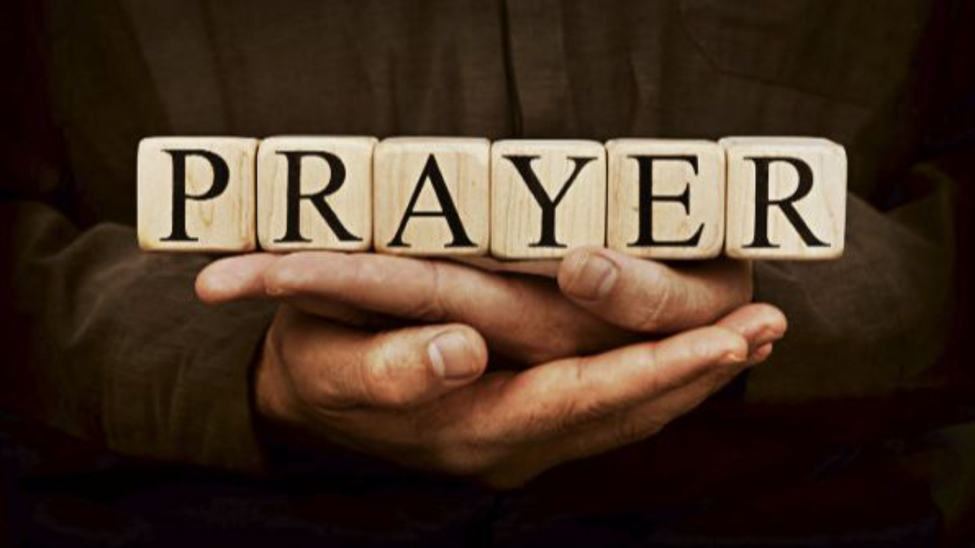

Slide 3
Hosanna (Praise Is Rising)
CCLI Song # 4662491
Brenton Brown | Paul Baloche
© 2005, 2006 Integrity's Hosanna! Music (Admin. by Integrity Music Ltd)
Thankyou Music (Admin. by Integrity Music Ltd)
For use solely with the SongSelect® Terms of Use. All rights reserved. www.ccli.com
CCLI Licence No. 33265

Slide 4
1/6
Praise is rising
Eyes are turning to You
We turn to You
Hope is stirring
Hearts are yearning for You
We long for You

Slide 5
2/6
‘Cause when we see You
We find strength to face the day
In Your presence
All our fears are washed away
(Washed away)

Slide 6
3/6
Hosanna Hosanna
You are the God who saves us
Worthy of all our praises
Hosanna Hosanna
Come have Your way among us
We welcome You here Lord Jesus

Slide 7
4/6
Hear the sound of
Hearts returning to You
We turn to You
In Your Kingdom
Broken lives are made new
You make us new

Slide 8
5/6
‘Cause when we see You
We find strength to face the day
In Your presence
All our fears are washed away
(Washed away)

Slide 9
6/6
Hosanna Hosanna
You are the God who saves us
Worthy of all our praises
Hosanna Hosanna
Come have Your way among us
We welcome You here Lord Jesus

Slide 10
This Is Amazing Grace
CCLI Song # 6333821
Jeremy Riddle | Josh Farro | Phil Wickham
© 2012 WC Music Corp. (Admin. by / Small Stone Media BV, Holland (Admin. in the UK/Eire by Song Solutions www.songsolutions.org))
Bethel Music Publishing (Admin. by Song Solutions)
Phil Wickham Music (Admin. by Song Solutions www.songsolutions.org)
Seems Like Music (Admin. by Song Solutions www.songsolutions.org)
Sing My Songs (Admin. by Song Solutions www.songsolutions.org)
For use solely with the SongSelect® Terms of Use. All rights reserved. www.ccli.com
CCLI Licence No. 33265

Slide 11
1/8
Who breaks the power of sin and darkness
Whose love is mighty and so much stronger
The King of Glory the King above all kings

Slide 12
2/8
Who shakes the whole earth with holy thunder
And leaves us breathless in awe and wonder
The King of Glory the King above all kings

Slide 13
3/8
This is amazing grace
This is unfailing love
That You would take my place
That You would bear my cross
You laid down Your life
That I would be set free
Oh Jesus I sing for all that You've done for me

Slide 14
4/8
Who brings our chaos back into order
Who makes the orphan a son and daughter
The King of Glory the King of Glory

Slide 15
5/8
Who rules the nations with truth and justice
Shines like the sun in all of its brilliance
The King of Glory the King above all kings

Slide 16
6/8
This is amazing grace
This is unfailing love
That You would take my place
That You would bear my cross
You laid down Your life
That I would be set free
Oh Jesus I sing for all that You've done for me

Slide 17
7/8
Worthy is the Lamb who was slain
Worthy is the King who conquered the grave
Worthy is the Lamb who was slain
Worthy is the King who conquered the grave
Worthy is the Lamb who was slain
Worthy is the King who conquered the grave
Worthy is the Lamb who was slain
Worthy worthy worthy

Slide 18
8/8
This is amazing grace
This is unfailing love
That You would take my place
That You would bear my cross
You laid down Your life
That I would be set free
Oh Jesus I sing for all that You've done for me

Slide 20
I Love You Lord (To My King)
Gatherhouse Music, Ryan Kennedy, Durell Comedy

Slide 21
1/8
You invite me
To sit down at Your table
Where I can taste and I can see
That You are good
and You are always faithful
To welcome me
The least of these

Slide 22
2/8
You bring beauty out of the ashes
To restore and to redeem
So I have come to pour out all my oil
All I have, this offering

Slide 23
3/8
I love You Lord, I love You
And I want to sing a sweet sweet melody
To tell You, that I love You
Let it be a sweet sweet melody
To my King

Slide 24
4/8
You inhabit the praises of Your people
So I know You're here, right now
With Your Spirit stirring all around me
Before Your glory, I bow

Slide 25
5/8
I love You Lord, I love You
And I want to sing a sweet sweet melody
To tell You, that I love You
Let it be a sweet sweet melody
To my King

Slide 26
6/8
In my coming and my going
I will praise You
From the evening through the morning
I will praise You
When I rise and when I fall
I will praise You through it all
I will sing a love song to my King

Slide 27
7/8
When I'm lonely and I'm doubting
I will praise You
On the mountain when I'm shouting
I will praise You
When I rise and when I fall
I will praise You through it all
I will sing a love song to my King

Slide 28
8/8
I love You Lord, I love You
And I want to sing a sweet sweet melody
To tell You, that I love You
Let it be a sweet sweet melody
To my King

Slide 30
As The Deer
CCLI Song # 1431
Martin Nystrom
© 1984 Restoration Music, Ltd.
For use solely with the SongSelect® Terms of Use. All rights reserved. www.ccli.com
CCLI Licence No. 33265

Slide 31
1/6
As the deer panteth for the water
So my soul longeth after Thee
You alone are my heart's desire
And I long to worship Thee

Slide 32
2/6
You alone are my strength my shield
To You alone may my spirit yield
You alone are my heart's desire
And I long to worship Thee

Slide 33
3/6
You're my friend and You are my brother
Even though You are a King
I love You more than any other
So much more than anything

Slide 34
4/6
You alone are my strength my shield
To You alone may my spirit yield
You alone are my heart's desire
And I long to worship Thee

Slide 35
5/6
I want You more than gold or silver
Only You can satisfy
You alone are the real joy-giver
And the apple of my eye

Slide 36
6/6
You alone are my strength my shield
To You alone may my spirit yield
You alone are my heart's desire
And I long to worship Thee

Slide 37
Worthy Of it All
CCLI Song # 6280644
David Brymer | Ryan Hall
© 2012 Common Hymnal Publishing (Admin. by Integrity Music Ltd)
Innerland (Admin. by Integrity Music Ltd)
Underground Treasure (Admin. by Integrity Music Ltd)
Wayfinder Music (Admin. by Integrity Music Ltd)
For use solely with the SongSelect® Terms of Use. All rights reserved. www.ccli.com
CCLI Licence No. 33265

Slide 38
1/4
All the saints and angels
Bow before Your throne
All the elders cast their crowns
Before the Lamb of God and sing

Slide 39
2/4
You are worthy of it all
You are worthy of it all
For from You are all things
And to You are all things
You deserve the glory

Slide 40
3/4
Day and night,
Night and day,
Let incense arise
(X4)
Day and night
Night and day

Slide 41
4/4
You are worthy of it all
You are worthy of it all
For from You are all things
And to You are all things
You deserve the glory

Slide 42
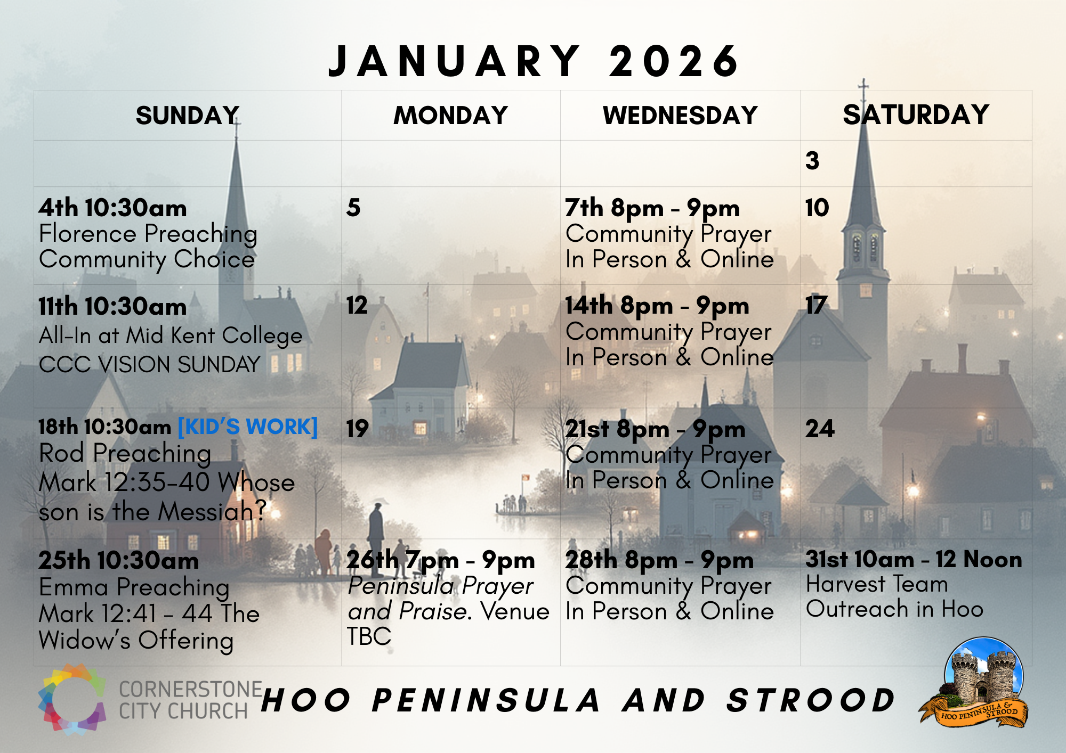

Slide 43


Slide 44
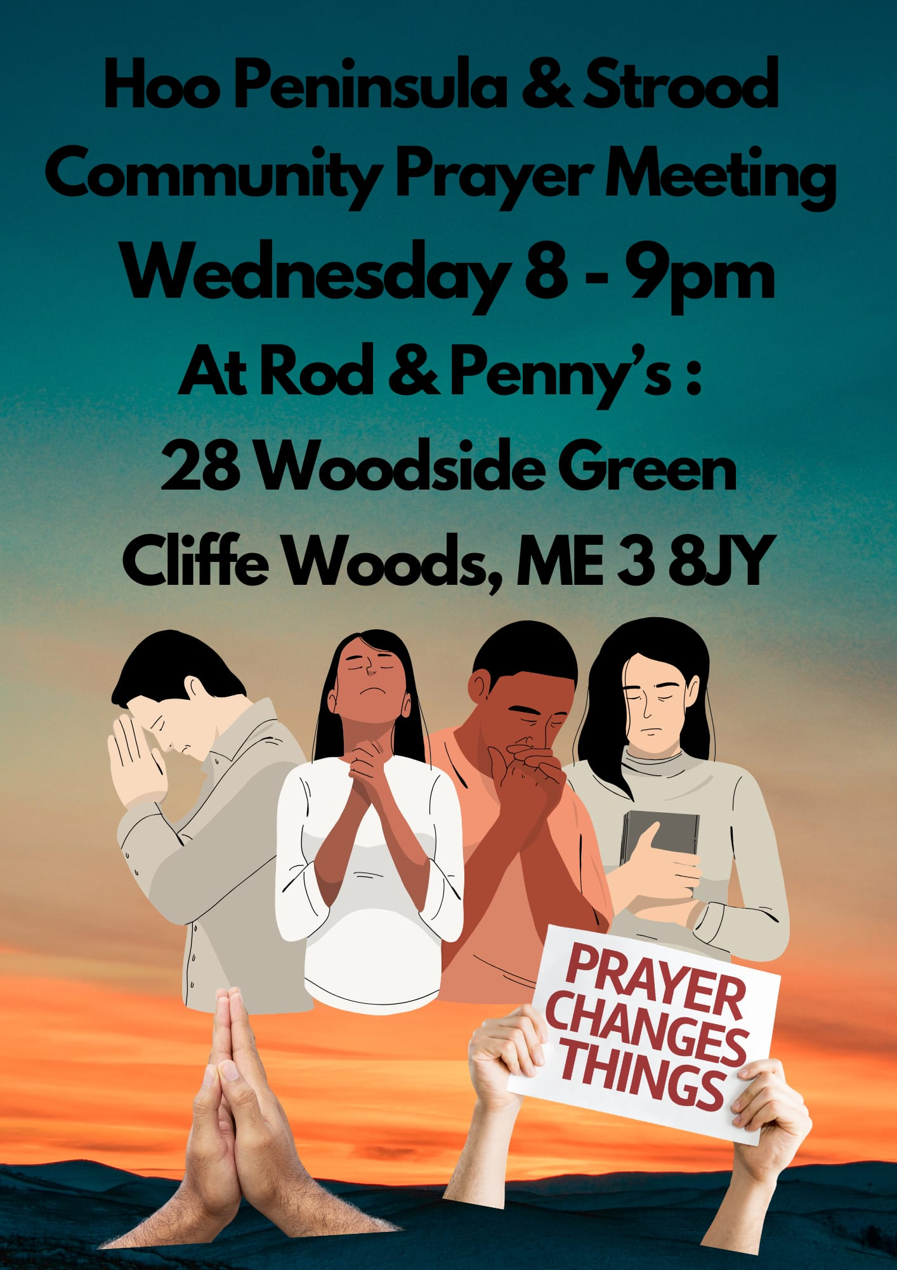

Slide 45
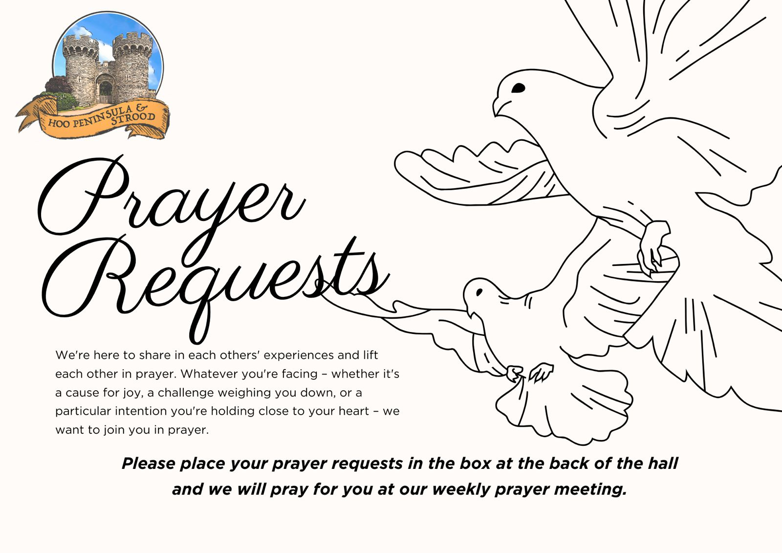

Slide 46


Slide 47
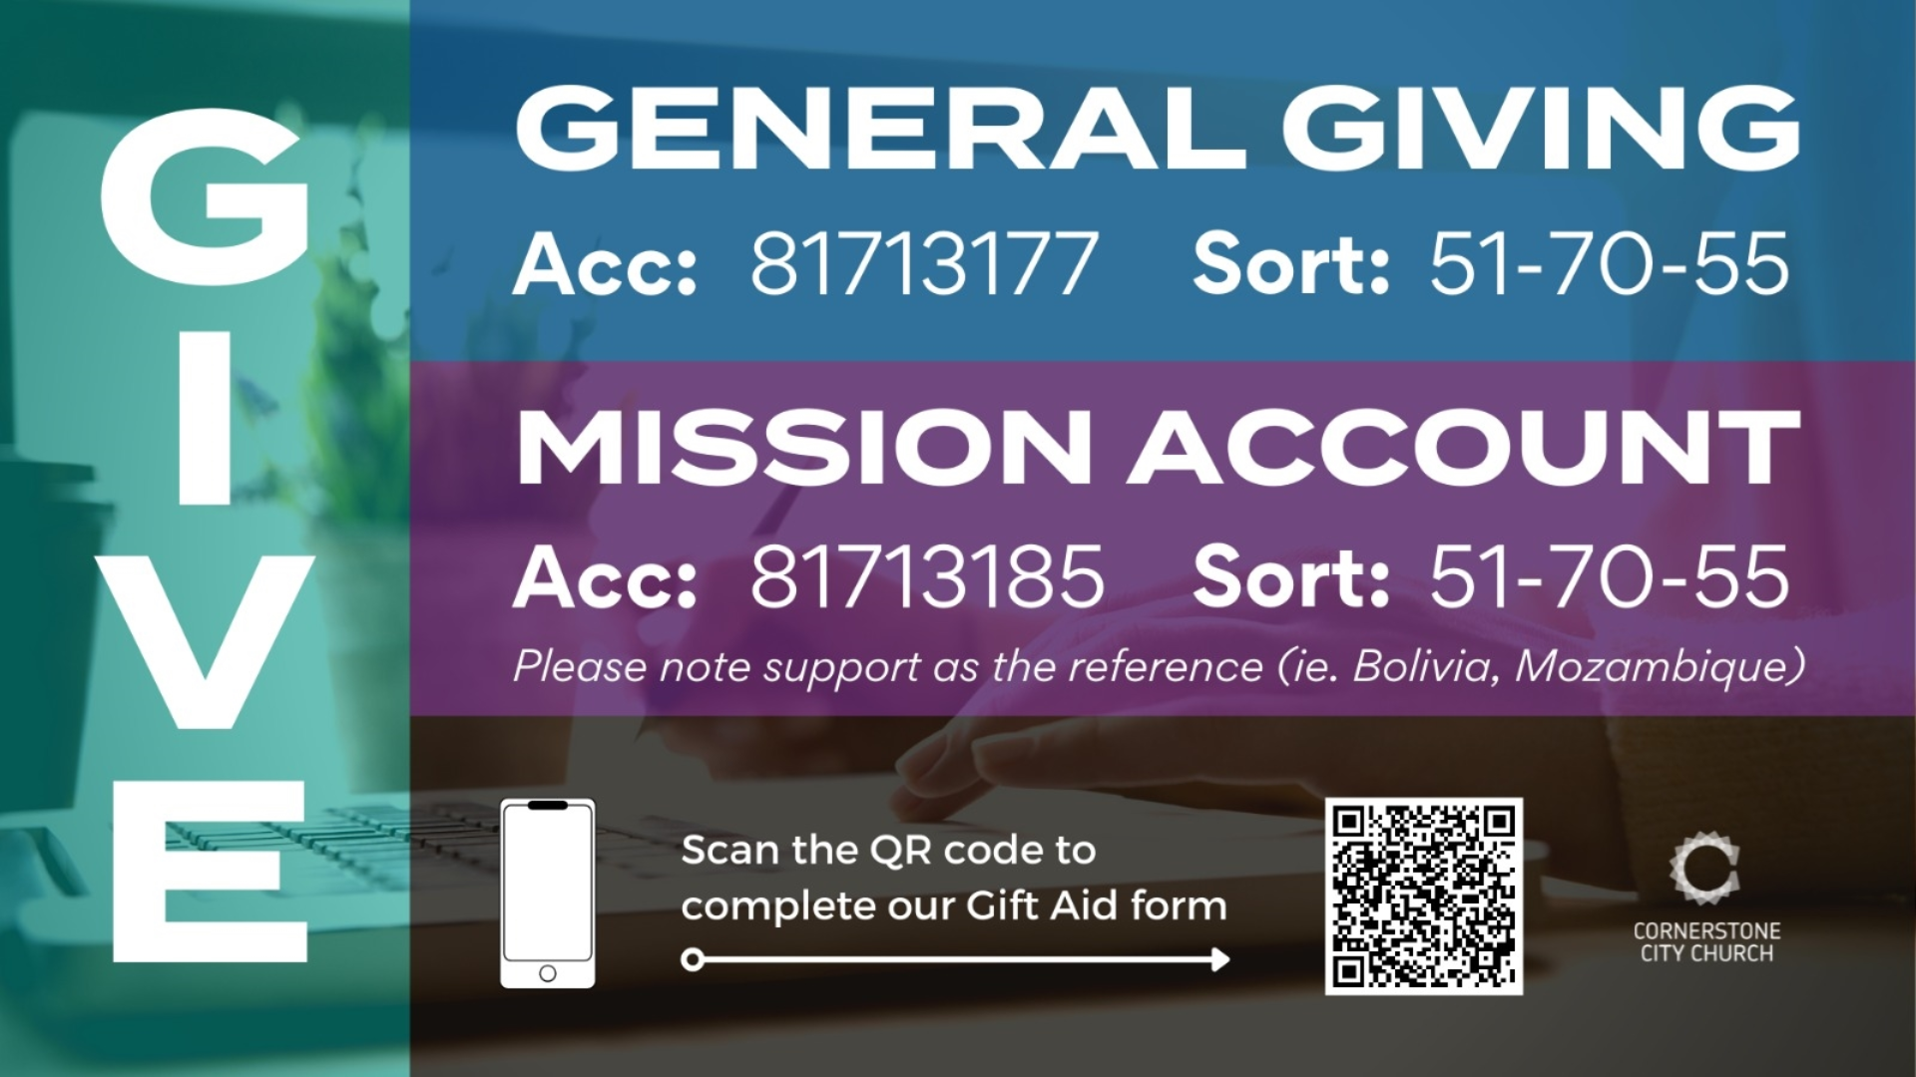

Slide 48


Slide 49
2 Corinthians 14 May the grace of the Lord Jesus Christ, and the love of God, and the fellowship of the Holy Spirit be with us all. And….
Surely goodness and mercy shall follow us all the days of our lives, and we shall dwell in the house of the Lord forever.

